Slide 1

Maximum likelihood estimation (MLE) and Least Square method

Slide 2
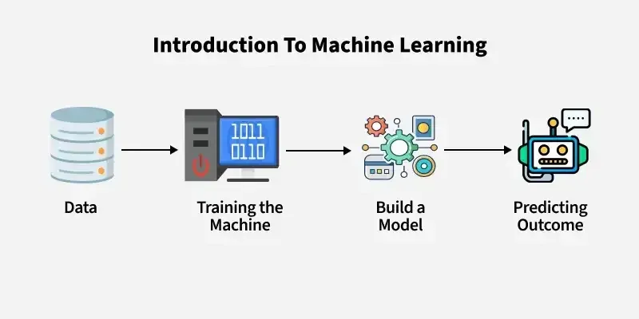
What is Machine learning ?
Machine learning(ML) allows computers to learn and make decisions without being explicitly programmed. It involves feeding data into algorithms to identify patterns and make predictions on new data. It is used in various applications like image recognition, speech processing, language translation, recommender systems, etc. In this article, we will see more about ML and its core concepts.

Slide 3
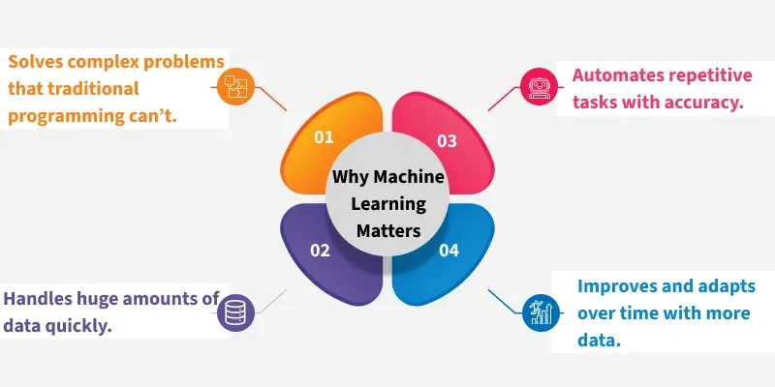
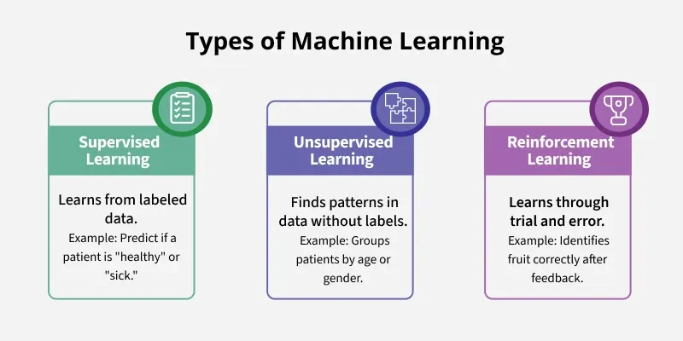

Slide 4
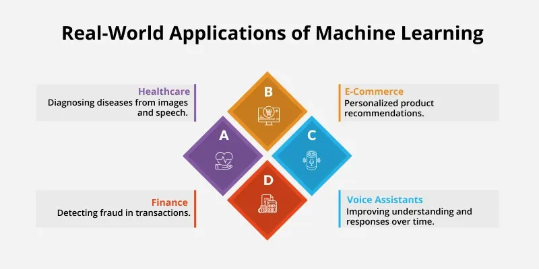
Why do we need Machine Learning?
Traditional programming requires exact instructions and doesn’t handle complex tasks like understanding images or language well. It can’t efficiently process large amounts of data. Machine Learning solves these problems by learning from examples and making predictions without fixed rules.

Slide 5
What Makes a Machine "Learn"?
A machine "learns" by identifying patterns in data and improving its ability to perform specific tasks without being explicitly programmed for every scenario. This learning process helps machines to make accurate predictions or decisions based on the information they receive. Unlike traditional programming where instructions are fixed, ML allows models to adapt and improve through experience.
Data Input: Machine needs data like text, images or numbers to analyze. Good quality and enough quantity of data are important for effective learning.
Algorithms: Algorithms are mathematical methods that help the machine find patterns in data. Different algorithms help different tasks such as classification or regression.
Model Training: During training, the machine adjusts its internal settings to better predict outcomes. It learns by reducing the difference between its predictions and actual results.
Feedback Loop: Machine compares its predictions with true outcomes and uses this feedback to correct errors. Techniques like gradient descent help it update and improve.
Experience and Iteration: Machine repeats training many times with data helps in refining its predictions with each pass, more data and iterations improve accuracy.
Evaluation and Generalization: Model is tested on unseen data to ensure it performs well on real-world tasks.

Slide 6
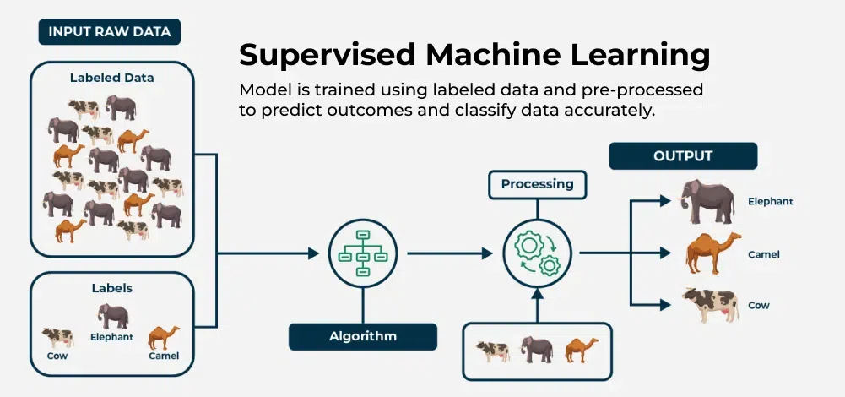
Types of Machine Learning
There are three main types of machine learning which are as follows:
Supervised learning trains a model using labeled data where each input has a known correct output. The model learns by comparing its predictions with these correct answers and improves over time. It is used for both classification and regression problems.

Slide 7
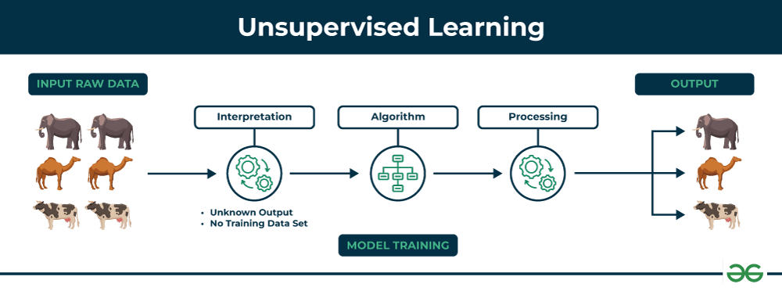
Unsupervised learning:
Unsupervised learning works with unlabeled data where no correct answers or categories are provided. The model's job is to find the data, hidden patterns, similarities or groups on its own. This is useful in scenarios where labeling data is difficult or impossible. Common applications are clustering and association.

Slide 8
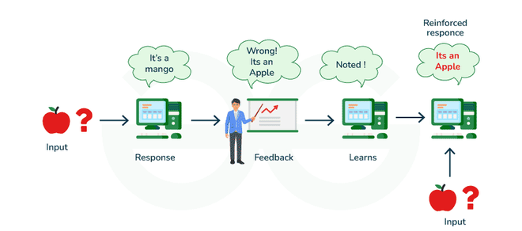
Reinforcement Learning (RL) trains an agent to make decisions by interacting with an environment. Instead of being told the correct answers, agent learns by trial and error method and gets rewards for good actions and penalties for bad ones. Over time it develops a strategy to maximize rewards and achieve goals. This approach is good for problems having sequential decision making such as robotics, gaming and autonomous systems.

Slide 9
What is parameter estimation?
Goal: estimate unknown parameters using data
Two popular methods:
Maximum Likelihood Estimation (MLE)
Least Squares Estimation (LSE)
Maximum Likelihood Estimation (MLE)
Intuition Behind MLE
Select parameters that maximize the probability of observed data
Likelihood = probability of data given parameters
Example: Coin toss — estimate the bias of a coin

Slide 10
Likelihood Function
Likelihood: L(θ)=P(X1,X2,...,Xn∣θ)
Often written as: L(θ)=∏i=1nf(xi∣θ)Log-likelihood: ℓ(θ)=log⁡L(θ)
MLE – Step-by-Step
Define the likelihood function
Take the log of the likelihood (log-likelihood)
Differentiate the log-likelihood w.r.t. parameter(s)
Set derivative = 0 and solve for parameter

Slide 11
MLE Example – Bernoulli Distribution
X∼Bernoulli(p)
Likelihood: L(p)=∏pxi(1−p)1−xi
Log-likelihood: ℓ(p)=∑xilog⁡p+(1−xi)log⁡(1−p)
MLE estimate: p^=1/n∑xi
Properties of MLE
Asymptotically unbiased
Consistent (converges to true value)
Efficient (lowest variance)
Sensitive to model assumptions

Slide 12
MLE in Linear Regression
Linear model: y=β0+β1x+ϵ
Maximizing this yields the Least Squares solution
Least Squares Estimation (LSE)
Introduction to Least Squares
Objective: Minimize the sum of squared differences between predicted and actual values
Loss function: SSE=∑i=1n(yi−y^i)2
Least Squares in Linear Regression
y=β0+β1x+ϵ
Minimize: ∑(yi−β0−β1xi)2
Closed-form solution using calculus or matrix algebra

Slide 13
Matrix Form of Least Squares
y=Xβ+ϵ
Estimate: β^=(XTX)−1XTy
Example – Least Squares Regression
Dataset: height vs weight
Fit a line: y=β0+β1x
Visualize the fit and residuals
Geometric Interpretation
Residual vector is orthogonal to fitted values

Slide 14
Assumptions of LSE
Linearity
Independence
Homoscedasticity
Normality of errors (for inference)
MLE vs Least Squares
Comparison Table
Feature | MLE | Least Squares
Objective | Maximize likelihood | Minimize error
Output | Parameter estimates | Parameter estimates
Based on | Probabilistic model | Deterministic error minimization
Connection | Equivalent when errors are Gaussian | Special case of MLE

Slide 15
When are They Equivalent?
When error terms are Gaussian: MLE≡Least Squares
MLE is more general (works for Poisson, Bernoulli, etc.)
Applications in Machine Learning
MLE: Logistic regression, Naive Bayes, HMMs
LSE: Linear regression, curve fitting
Both foundational for optimization-based learning

